Slide 1
Helianthus Vincent®s Series
January 2012
Product Management Cut Flowers

Slide 2
Sunflower F1 Vincent®s Series
Features and Benefits:
Vincent®s are faster than competitive varieties – a shorter crop cycle means quicker profits!
Day length neutral - better length under short days, more flexibility in programming
Round, overlapping petals form sturdy flower heads that hold up better during transport
An extra ring of petals provides a better filled and more attractive flower
Upward facing flowers don’t hang their heads, but look consumers proudly in the eye
Deep orange colour of Vincent®s Choice is the true ‘Sunflower shade’ that customers prefer
Green heart of Vincent®s Fresh is a crisp, clear alternative to the current Sunflower market selection

Slide 3
Sunflower F1 Vincent®s Series
Sakata’s Sunflower Vincent®s series offers earlier flowering, and stronger flower stems (including a stronger neck), and flowers with more rounded petals.
Vincent®s are also highly suited for the production of dwarf-type flowers for use in bouquets.

Slide 4
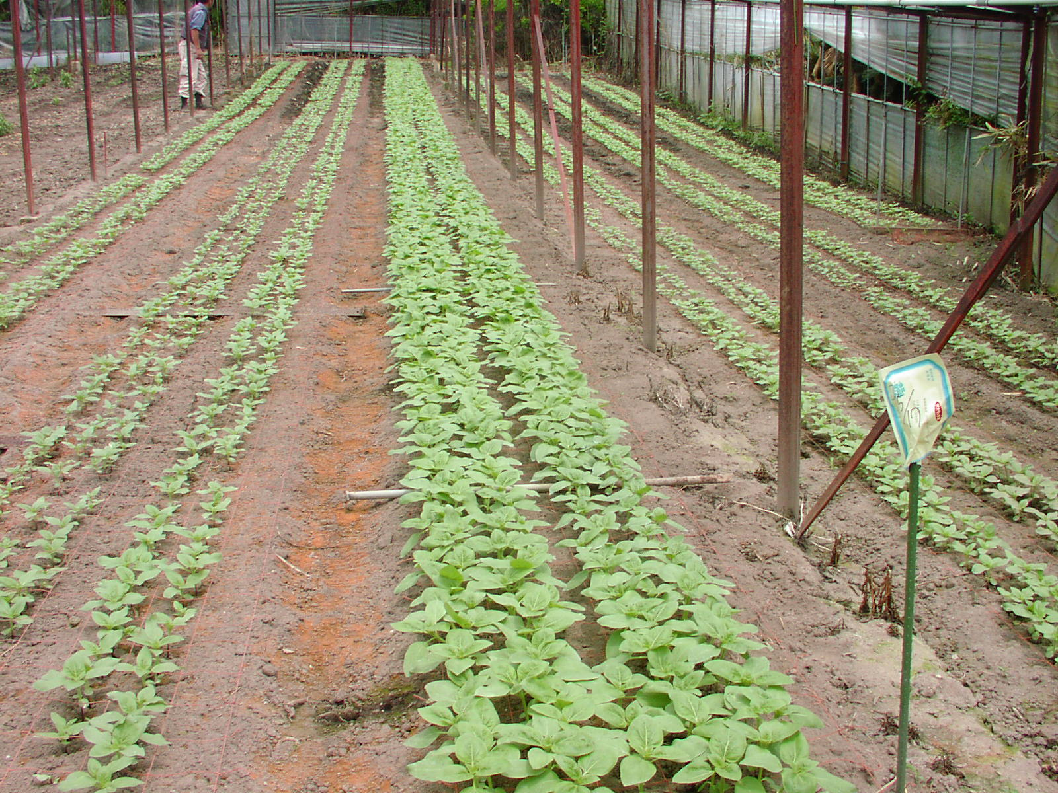
Sunflower F1 Vincent®s Series
Vincent’s are faster than competitive varieties – a shorter crop cycle means quicker profits!
Competitor’s Variety S
Orange Extra Early Type
Competitor’s Variety S
Orange Extra Early Type
F1 Vincent®s Choice
18 days after sowing

Slide 5
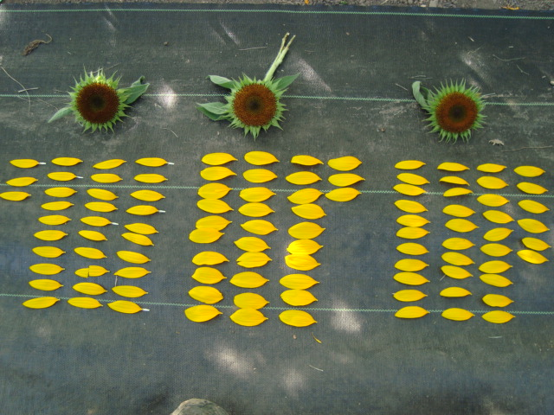
Sunflower F1 Vincent®s Series
Round, overlapping petals from sturdy flower heads that hold up better during transport
Competitor‘s
Variety S
Orange
F1 Vincent®s Choice

Slide 6
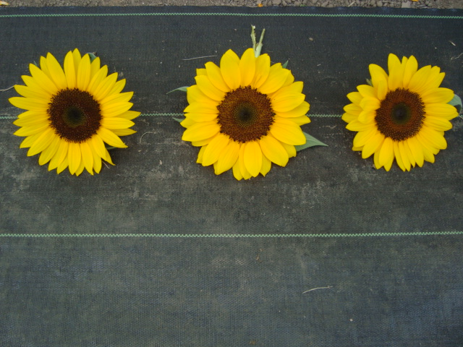
Sunflower F1 Vincent®s Series
An extra ring of petals provides a better filled and more attractive flower
Competitor‘s
Variety S
Orange
F1 Vincent®s Choice

Slide 7
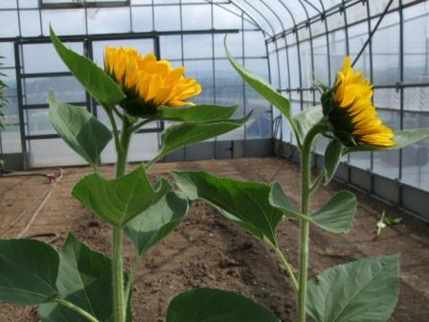
Sunflower F1 Vincent®s Series
Upward facing flowers don’t hang their heads, but look consumers proudly in the eye
Vincent®s is much more upward-facing
than competitive varieties

Slide 8
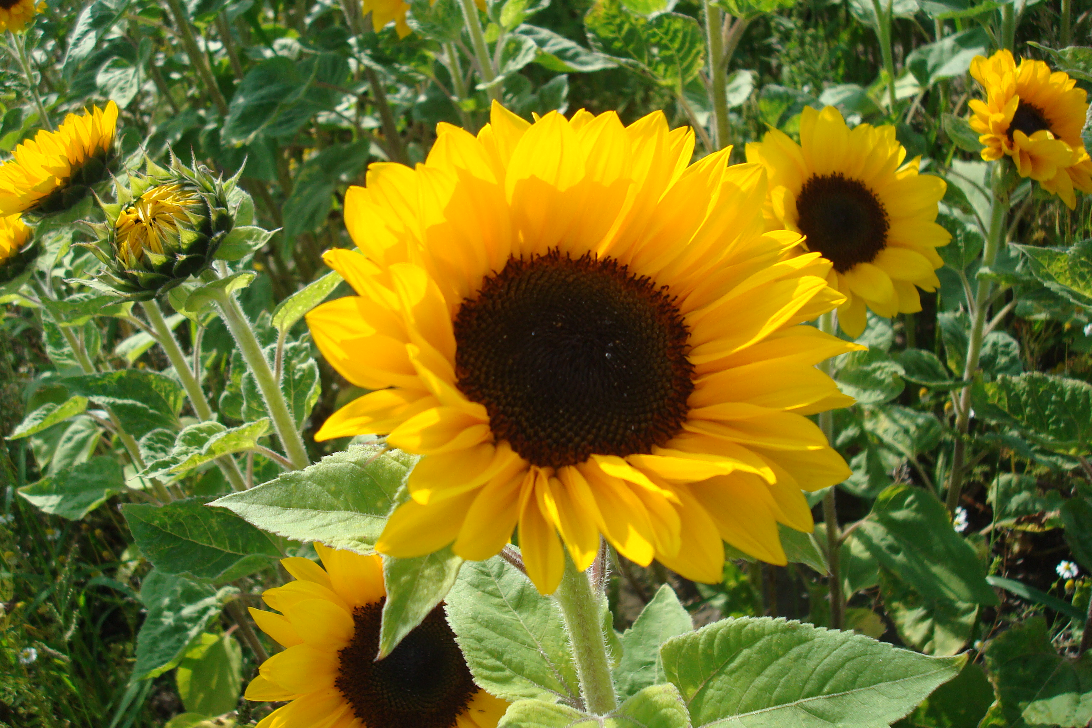
Sunflower F1 Vincent®s Choice
Deep Orange colour of Vincent®s Choice is the true “Sunflower shade” that customers prefer

Slide 9
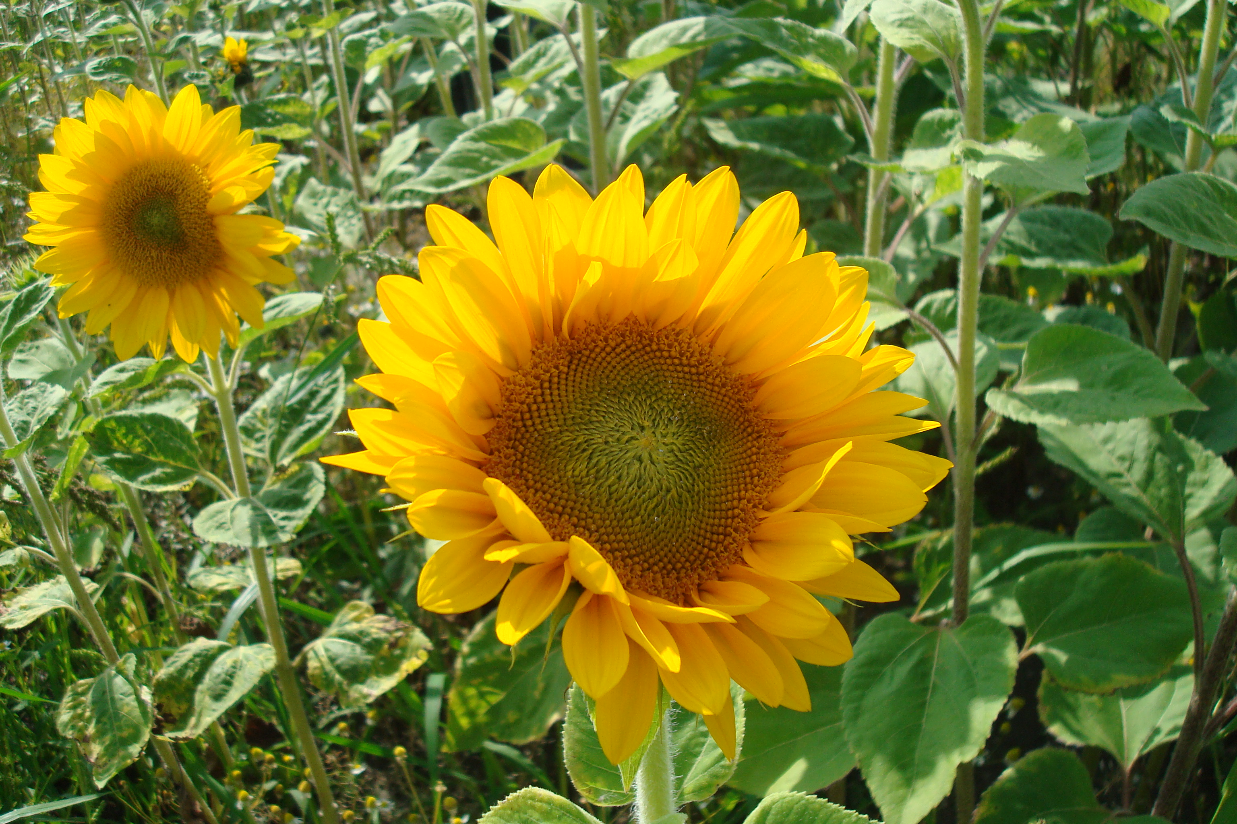
Sunflower F1 Vincent®s Fresh
Green heart of Vincent®s Fresh is a crisp, clear alternative to the Sunflower market selection

Slide 10
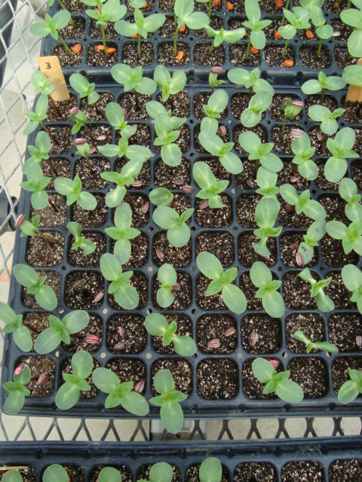
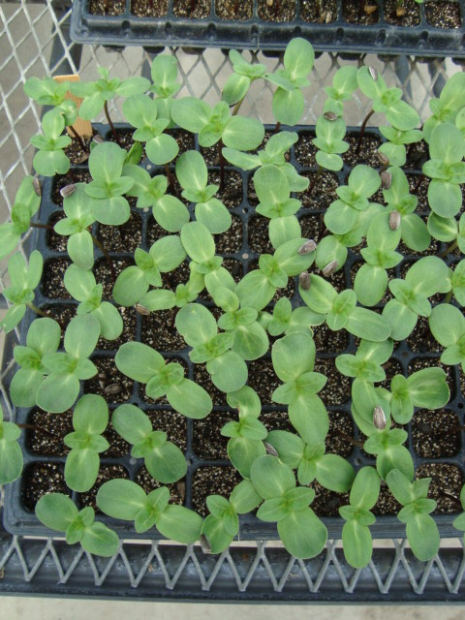
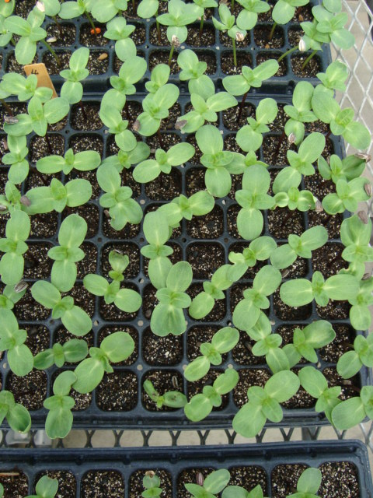
Sunflower F1 Vincent®s Series
Variety Character - High germination rate
Competitor’s
variety S Orange
F1 Vincent®s Choice
(Orange)
F1 Vincent®s Fresh (Yellow/Green)

Slide 11
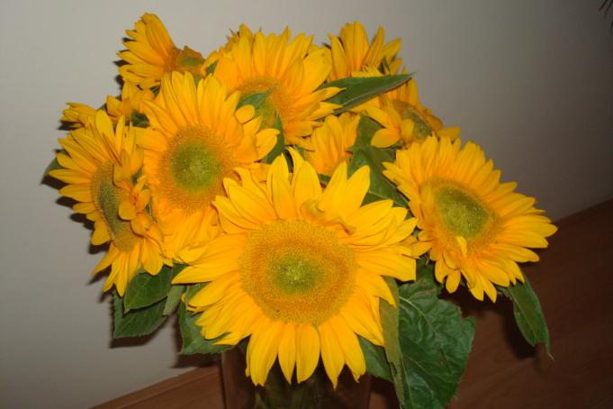
Sunflower F1 Vincent®s Fresh
In the vase – The Netherlands

Slide 12
Sunflower F1 Vincent®s Fresh
Evaluation of the varieties – General observations The Netherlands
Cycle: 74 days
Height of stem: 150 - 160 cm
Diameter of flower: 12 – 18 cm
Diameter of heart: 4,5 – 5,0 cm
Firm stems
Uniform flower height
Uniform flower size
Some disformed flowers
Dutch grower wants to try the market !!
Which is unique as within
The Netherlands
the market asks for black disc

Slide 13
Sunflower F1 Vincent®s Choice
The Netherlands

Slide 14
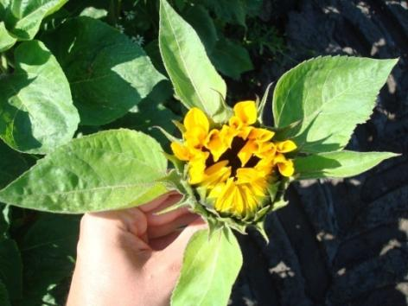
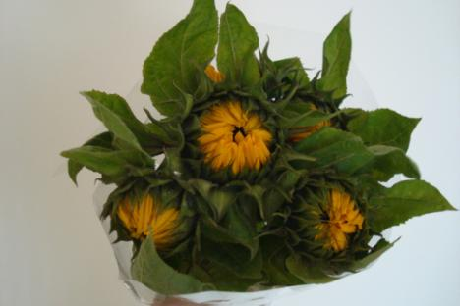
Sunflower F1 Vincent®s Choice
The Netherlands - Harvesting stage Vincent’s Choice
Opens uniformly and round to desired specification !

Slide 15
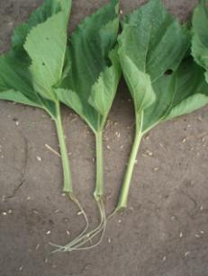
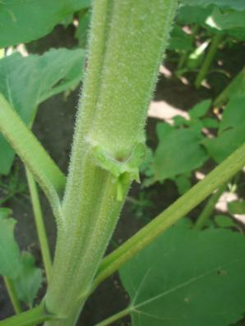
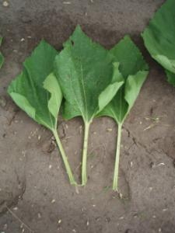
Sunflower F1 Vincent®s Choice
Clean cuts, hardly any wounds whilst stripping foliage
↓Vincent®s
Choice →
↑Competitor

Slide 16
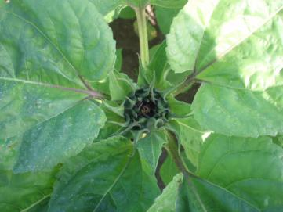
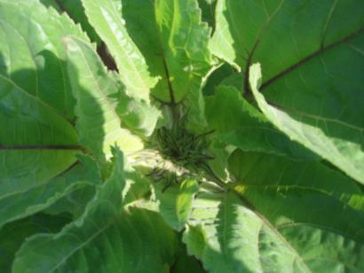
Sunflower F1 Vincent®s Choice
Good aeration – no “hanging” dew and drops – much less risk for damage
↓ Vincent®s Choice
Competitor ↓

Slide 17
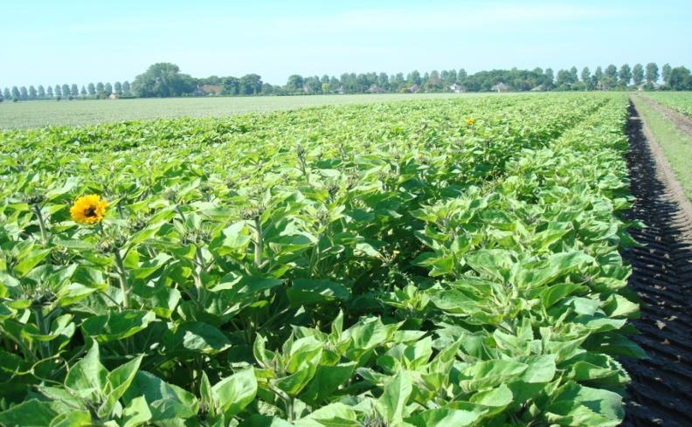
Sunflower F1 Vincent®s Series
1st Sowing of Helianthus, flowering stage (De Witte)
CHOICE
FRESH
SUNRICH ORANGE

Slide 18
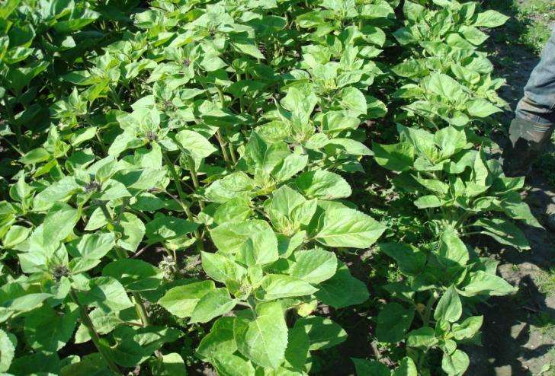
Sunflower F1 Vincent®s Series
2nd Sowing of Helianthus, growing stage (De Witte)
CHOICE
FRESH
SUNRICH
ORANGE

Slide 19
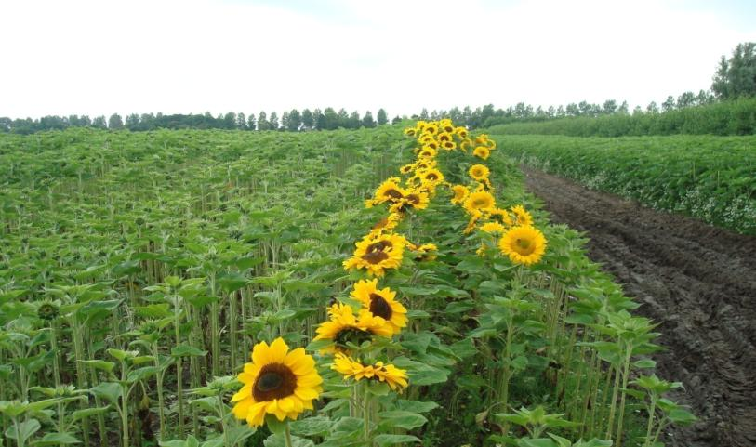
Sunflower F1 Vincent®s Series
2nd Sowing of Helianthus, flowering stage (De Witte)
SUNRICH ORANGE
CHOICE
FRESH

Slide 20
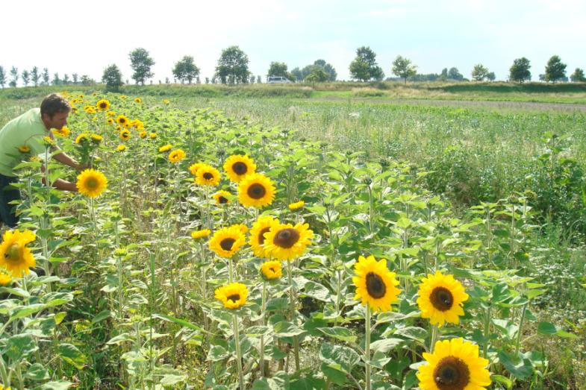
Sunflower F1 Vincent®s Series
1st Sowing of Helianthus (Rietkerk)
FRESH
CHOICE
SUNRICH ORANGE

Slide 21
Sunflower F1 Vincent®s Choice
Evaluation of the varieties – General observations - NL
Cycle: 71 days (10 days faster than Sunrich Orange)
Height of stem: 140 - 160 cm
Diameter of flower: 10 – 11 cm
Diameter of heart: 4,0 - 4,5 cm
Firm stems
Uniform flower height and flower size
Remark of grower: “ Next year I will only grow Choice. Faster and better quality compared to Sunrich Orange. Also lower height is better, less chance of falling down due to heavy winds” .

Slide 22
Sunflower F1 Vincent®s Series
Evaluation of the varieties – Cycle data - The Netherlands
 | Sowing Date | Flowering Date | Length cycle | Harvest Window
Choice | 6th April | 15th June | 70 | 6 days
Fresh | 6th April | 18th June | 73 | 6 days
Sunrich Orange | 6th April | 24th June | 79 | 6 days
Choice | 19th April | 5th July | 77 | 5 days
Fresh | 19th April | 8th July | 80 | 5 days
Sunrich Orange | 19th April | 13th July | 85 | 5 days
Choice | 29th April | 10th July | 72 | 5 days
Fresh | 29th April | 13th July | 75 | 5 days
Sunrich Orange | 29th April | 18th July | 80 | 5 days
Choice | 1st May | 13th July | 73 | 5 days
Fresh | 1st May | 16th July | 76 | 5 days
Sunrich Orange | 1st May | 20th July | 80 | 5 days

Slide 23
Sunflower F1 Vincent®s Series
Evaluation of the varieties
Large trials at growers Mts. Rietkerk, de Witte,
van Vlimmeren and small trials via Dutch key distributor.
Trial results Research Station SCRADH (France), Research Station Heidelberg (Germany) expected within a few weeks – German key distributor already commented; “Finally a variety that beats Sunrich Orange”
Trial results via key distributors in France, Italy, Spain, Portugal, Hungary, Germany, England, Poland and Kenya.

